Slide 1

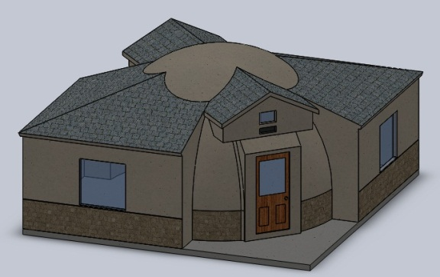
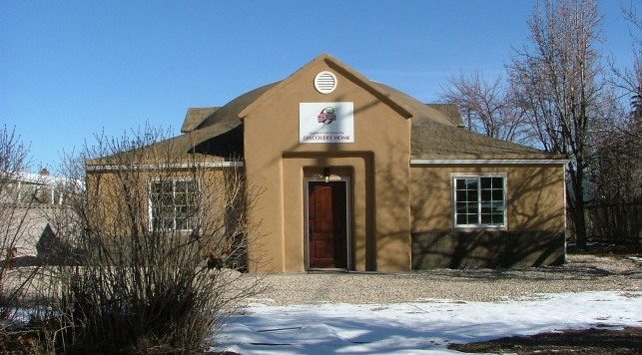
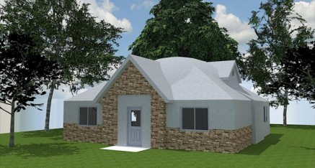

March 23, 2012
“Kenyans Building Kenya”

Slide 2

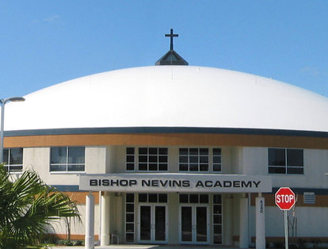
Modern Arch Structure
Not a Dome, but an Arch
Reinforced Concrete
  Shotcrete
    MASTM 1300
      1,300 sqft 1st & 500 sqft 2nd Floor
    MASTM 570
      Single Storey 570 sqft
Complete in 4-7 days
  8 hour Shifts per Day
Local Materials

Slide 3

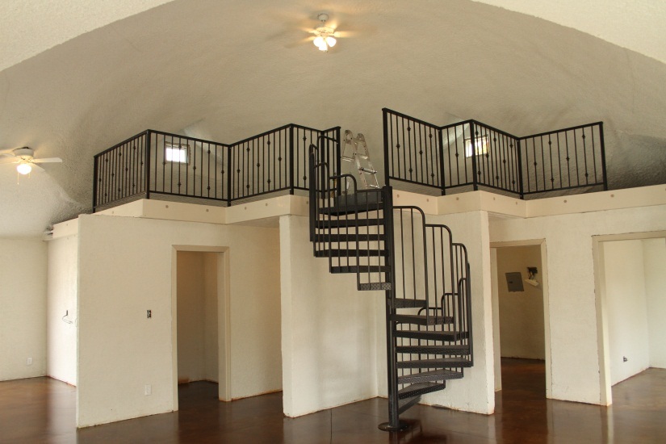
MASTM 1300
20 Year Unconditional Warranty
  Natural Disasters
  Fires
  “Acts of God”

Slide 4
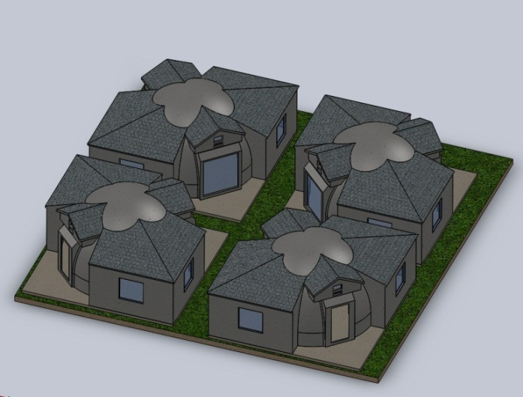

MASTM 570
MASTM Monolithic 4 Inch Walls
  4 Layers of Shot crete
Walls – Smooth, Textured or Stamped
  Shingles
  Rock
  Brick
  Block
  Wood
  Let Your Imagination Run!

Slide 5
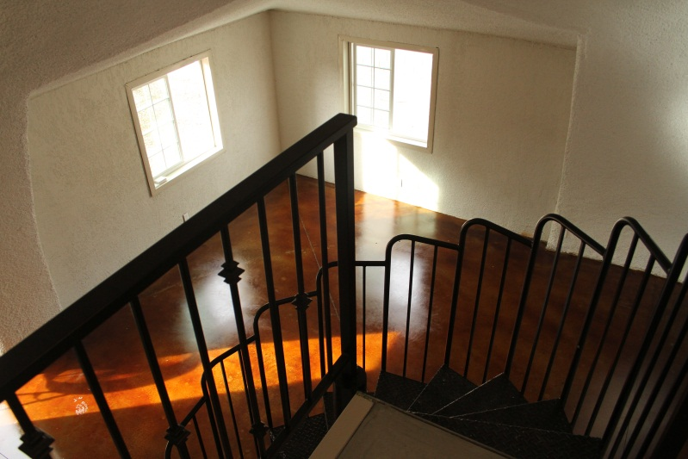

MASTM Interior
Insulation is MAStiliteTM
  Up to R60 Value Equiv
  Conduit in Insulation
  Sound Absorbing
  Can texture as you like
Interior Design
  Open or Rooms
  Mezzanine or not

Slide 6
MASTM 1300 Barracks
AP Barracks
  5 Buildings
  60 Police Total
    12 to a Building
Service Staff
  1 Building
  12 Service Staff
Security Force
  1 Building
  24 Force Total
      Bunk Beds

Slide 7
MASTM 570 Officers Quarters
Officers Quarters
  1 Building
  3 Officers
  Lobby
  Shared Bathroom
  Single Bedrooms
    Bed
    Wall Locker
    Desk
    Nightstand
    Refrigerator

Slide 8
MASTM 1300 DFAC
DFAC
  Full Kitchen
    Serving Line
    Cold Storage
      Freezer
      Refrigeration
    Dry Storage
  Capacity of 64
  Optional Uses
    Classroom
    MWR

Slide 9
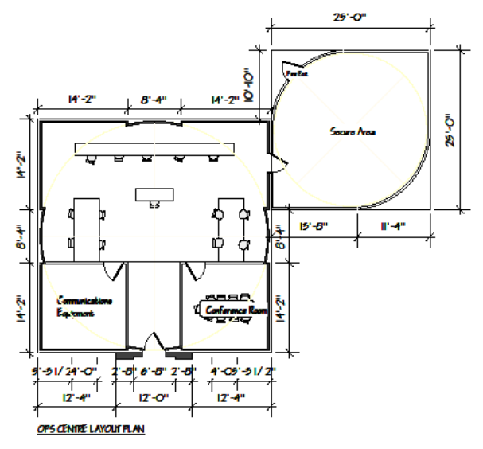
MASTM 1300 & 570 Ops Center
Operations Center
  Main Building 1300
    Conf Room
    Comm Room
      Design TBD
    Ops Center
  Secure Building 570
    Configured to Ops

Slide 10
MASTM 1300 Gym - Med
Gym
  Cardio Equip
Medical Clinic
  Treatment Room
Classroom
  Seats 15
Small Mezzanine
  2nd Floor Loft - Storage

Slide 11
MASTM 570 Trainers & Staff
Trainer’s Quarters
  5 Buildings
Sr. Service Staff
  1 Building
Configuration
  Holds 3 People
    Common Area
    Patio
    Individual Loo

Slide 12
MASTM 1300 Warehouse
Warehouse
  Storage
    Over 160 Pallets
    Logistician Office
  Armory
    Small Arms

Slide 13
MASTM 570 Motor Pool
Motor Pool
  One Vehicle
    Hilux
    Land Cruiser
    Humvee
  Mechanic Pit
  Tool Storage
  Repair Parts

Slide 14
MASTM 570 VIP Quarters
VIP Quarters
  1 Building
    2 Bedrooms
    Foyer
    Living Room
    Patio
    Individual Loo

Slide 15
MASTM 570 Laundry & Maint
Laundry
Maintenance Shop
  1 Building
    Washing Machines
    Pressing
    Maintenance Shop
    Office

Slide 16
MASTM FOB Dadaab
Overall Compound - 240m X 146m
  Houses 119 People
    60 Admin Police
    27 Guard Force
    15 Trainers
    15 Service Staff
    2 VIP Guests
  Security
    Entry Control
    4 Guard Towers
  Utilities
    Septic, Standby Emergency Gensets & Fuel Tanks

Slide 17
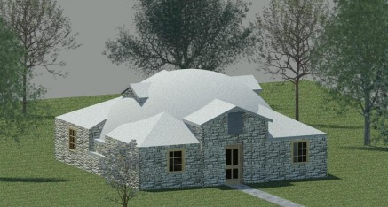
Questions?

